Slide 1


UNRAVELING DIABETES DETECTION
A COMPARATIVE STUDY OF MACHINE LEARNING APPROACHES
24 June, 2024

Slide 2
Our study utilizes Machine Learning to identify early diabetes cases, aiding in proactive treatment and improving patient outcomes. By comparing different ML algorithms, we aim to optimize diabetes diagnosis in healthcare, with potential implications for personalized medicine and enhanced patient well-being.
ABSTRACT

Slide 3
TABLE OF CONTENTS
01
05
INTRODUCTION
ABOUT THE DATASETS
02
06
MOTIVATION
MODELS USED
03
07
LITERATURE SURVEY
CONCLUSION
04
08
DATA PROCESSING
FUTURE SCOPE

Slide 4
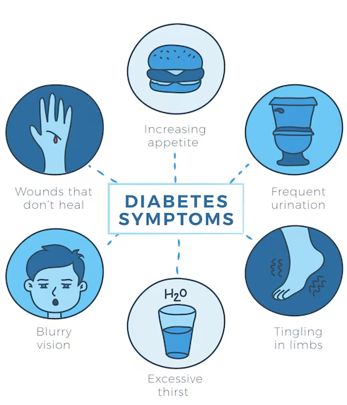
INTRODUCTION
Diabetes, a prevalent chronic condition, arises when the body struggles to regulate blood sugar levels adequately. It comes in two primary forms: type 1, where the body fails to produce insulin, and type 2, where cells become insulin-resistant. Left untreated, diabetes can lead to severe complications, including heart disease and nerve damage. Understanding its mechanisms and management is pivotal for promoting healthier lifestyles and minimizing associated risks.

Slide 5
MOTIVATION
Rising Prevalence in Diabetes- Diabetes is becoming more common worldwide, placing a significant strain on healthcare systems. There is an urgent need for better detection methods. Using advanced machine learning techniques can help address this growing health challenge and align with global health priorities.
Advances in Machine Learning- Recent advances in machine learning offer new ways to improve diagnostic accuracy and efficiency. This study aims to use these advancements to make practical healthcare applications more effective.
Benchmarking and Best Practices- By comparing different machine learning algorithms, this research aims to set standards and best practices for detecting diabetes. This helps future studies and practitioners choose the best tools for real-world use.

Slide 6
LITERATURE SURVEY
Key Studies & Findings:
Sisodia et al. : Algorithms: SVM, NB, DTs; Dataset: Pima Indians Diabetes Dataset; Best accuracy: 76.30% (NB)
Rastogi et al. :Algorithms: RFC, K-means, Linear & Logistic Regression, DTs, SVM, NB; Dataset: Kaggle; Best accuracy: 82.46% (Logistic Regression)
Daanouni et al. : Algorithms: ANN, kNN, DNN, DTs; Dataset: PID; Best accuracy: 90% (Feed-forward DNN)
Xue et al. : Algorithms: SVM, NB, LightGBM; Dataset: Sylhet Diabetes Hospital, Bangladesh
Dutta et al. : Algorithms: NB, RFC, DT, XGBoost, LightGBM; Dataset: DDC, Bangladesh; Best accuracy: 96% (Logistic Regression)
Zou et al. : Algorithms: RF, DTs, Deep Learning; Dataset: Luzhou Hospital, China; Best accuracy: 80.84% (RFC)
Key Takeaways:
Logistic Regression and RFC are consistently high performers.
Deep Neural Networks show high effectiveness in complex datasets.
Dataset choice significantly impacts algorithm performance.
Exploring various ML approaches is crucial.
Research Gaps:
Need for standardized benchmarks.
Exploration of advanced deep learning and ensemble methods.
Increase diversity in datasets for better generalization.

Slide 7
DATA PREPROCESSING
Our study utilizes Machine Learning to identify early diabetes cases, aiding in proactive treatment and improving patient outcomes.
01
02
03
DATA COLECTION
DATA STANDARDIZATION
DATA SPLITTING
Three Datasets were taken from Kaggle to predict the presence od DIabetes based on various health indicators
Used fit method to calculate mean and standard deviation, and transform method to standardize the data
80% of the data used for training, 20% for testing to evaluate model performance.

Slide 8
01
02
ABOUT THE
DATA SETS
DIABETES DATASET
DIABETES PREDICTION DATASET
This Dataset has 769 entries and 9 features. It focuses on Pima Indian women, making it specific to this population group only.
This Dataset has 100001 entries and 9 features. It includes general health indicators without specifying a
population, suggesting broader applicability.
A large dataset is needed to undertake a comparative study of various features and models. Here, we have used three datasets from different sources and with different numbers of features in the data set. We sourced the data sets from Kaggle,making them more resilient and versatile.
03
DIABETES HEALTH INDICATORS DATASET
This Dataset has 253681 entries and 22 features. It contains diverse demographic and health data, making
it suitable for general applicability across various populations.

Slide 9
MODELS USED
01
02
03
NAIVE BAYES (GAUSSIAN NAIVE BAYES)
SUPPORT VECTOR MACHINE
K-NEAREST NEIGHBOURS
04
05
DECISION TREES
RANDOM FOREST

Slide 10
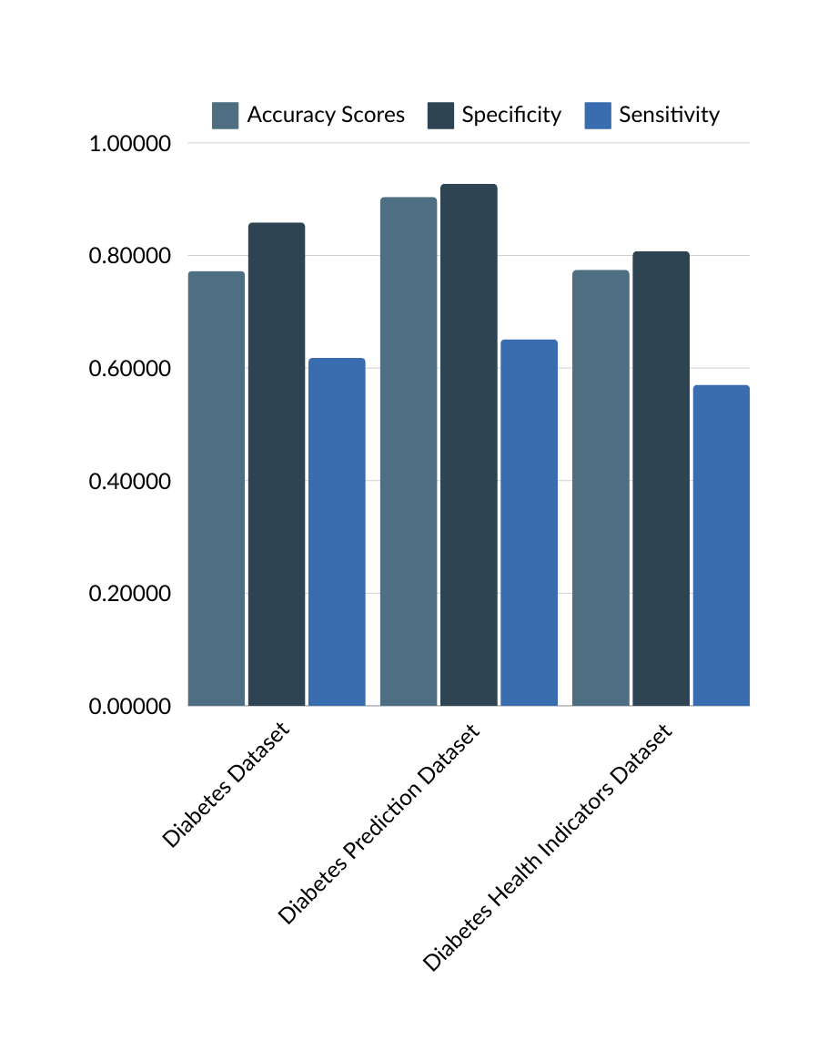
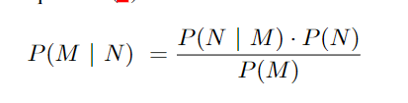
NAIVE BAYES (GAUSSIAN NB)
Uses the idea that all features have a normal distribution.
The algorithm hypothesizes the presence of one feature of a certain group as unbiased and independent of the other feature.
The model’s performance is considered by determining its accuracy.
The mathematical formula for Bayes Theorem is:
0.772727
0.858586
0.618182
0.774539
0.807561
0.927263
0.570417
0.651381
0.90380
Where:
P (M | N ) denotes the posterior probability of class (M) given predictor (N).
P (M ) and P (N ) are the probabilities of class and predictor respectively.
P (N | M ) signifies the likelihood, which is the probability of the predictor given the class.

Slide 11
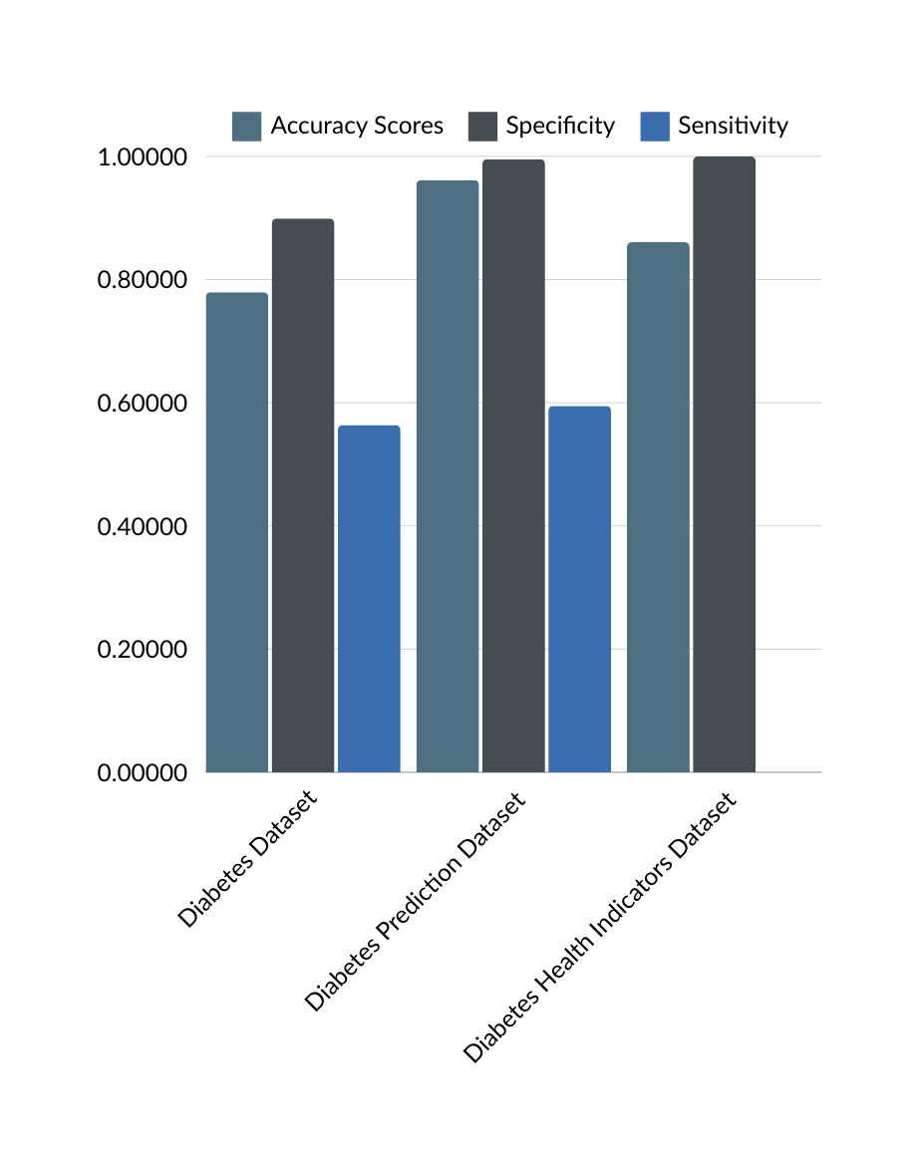
SUPPORT VECTOR MACHINE (SVM)
For linear and non-linear classification, regression, and outlier detection.
Creates a hyperplane that separates an N-dimensional space into distinct classes.
Aim: To find a hyperplane that maximizes the separation margin between two classes.
Selects a hyperplane with the maximum distance from the nearest data points on either side, known as the maximum margin hyperplane if it exists.
Used in image detection, spam detection, and face detection.
0.779221
0.898989
0.563636
0.860750
0.995409
1.000000
0.594944
0.000000
0.96130

Slide 12
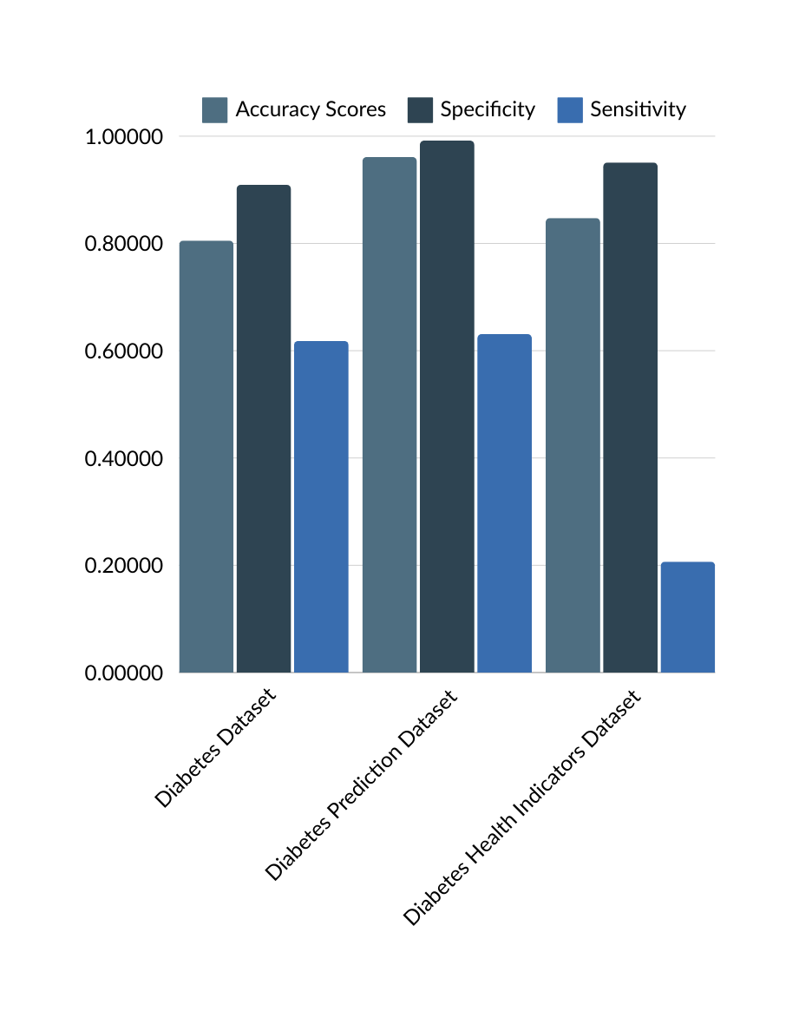
K-NEAREST NEIGHBOURS(KNN)
Easy, straightforward, and accurate based on the samples closest to the reference as possible, known as the neighbors.
This can be calculated using Euclidean Distance, Manhattan Distance.
This specific model will assess the five nearest neighbors for its predictions. (k = 5)
For this model, we applied Euclidean distance which can be calculated as:
0.805195
0.909091
0.618182
0.847406
0.951020
0.991802
0.206794
0.630805
0.96110
Where d and e are the two points in the data collection.
&
are the
coordinates respectively.
n is the number of dimensions or features in the dataset.

Slide 13
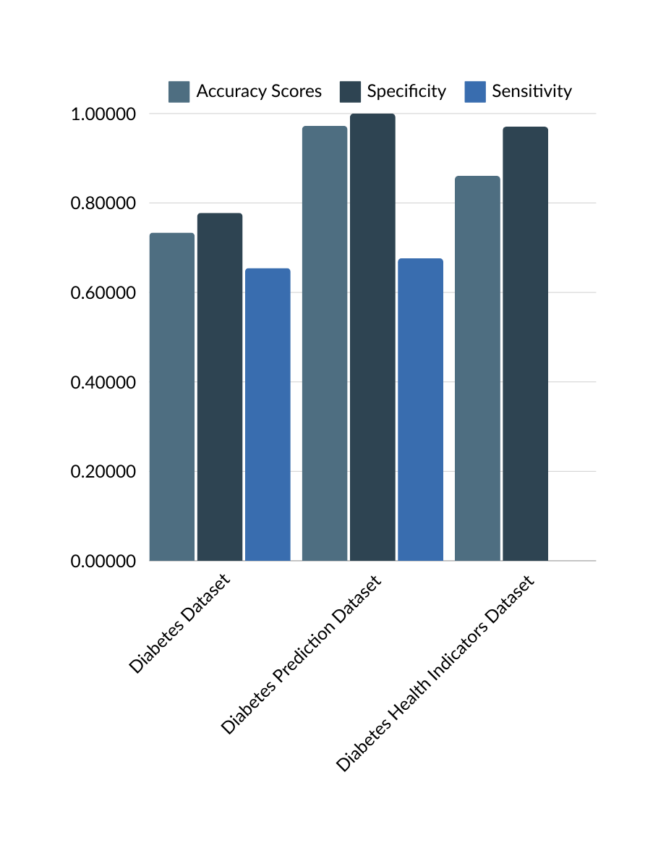




DECISION TREE
Decides choices based on questions and a criteria framework.
Like a flowchart, a node means a feature, a branch means a decision and a leaf points to the result.
Components: Root Node, Decision Node, and Leaf Node.
The criterion used is entropy and it is calculated as:
0.733766
0.777778
0.654545
0.860750
0.970735
1.000000
0.000000
0.676072
0.97245
= Entropy of dataset S
= Proportion of instances in S
= Number of classes
Information gain is the reduction in entropy or surprise by splitting a feature and it is calculated as:
= Subset of S for which attribute A has value v
Values(A) is the set of all possible values for an attribute A, and S is the whole sample space.

Slide 14
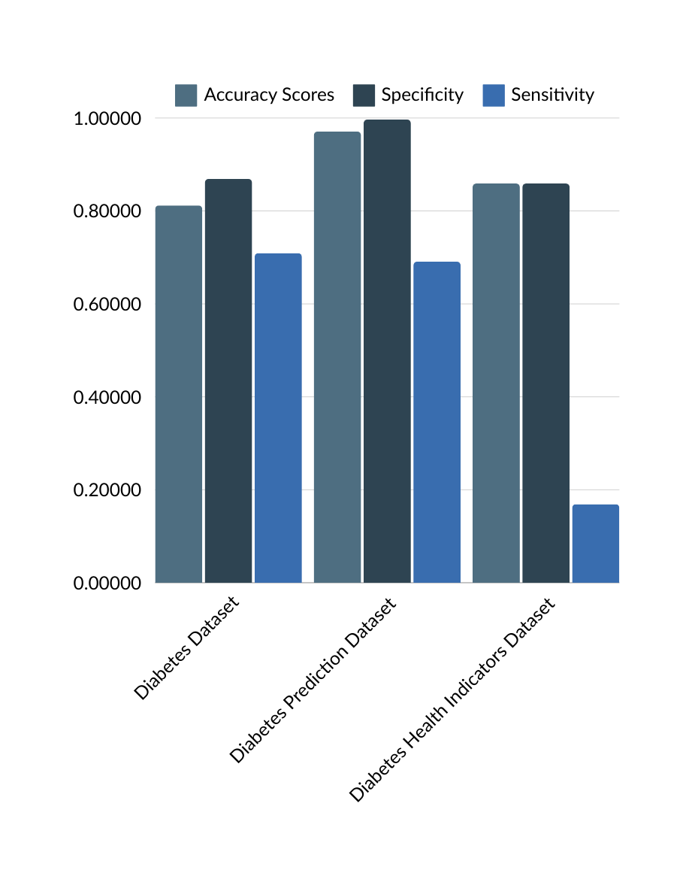
RANDOM FOREST CLASSIFIER
Works by creating several DTs during the training phase.
While predicting: the algorithm totals the results of all trees.
For classification tasks: the preferred method of decision-making is through voting.
For regression tasks: the preferred method is through averaging.
In our model, we configured a Random Forest Classifier (RFC) with the following parameters:
0.59094
0.811688
0.868687
0.709091
0.859094
0.859094
0.996557
0.169002
0.690770
0.97055
Estimators=100
max depth=100
min samples split=20
min samples leaf=1
max features is set to the square root of the total number of features
the random state is set to 5.

Slide 15
CONCLUSION
Best Model: Random Forest Classifier (RFC) demonstrated the highest predictive accuracy and robustness.
Variability: Outcomes varied across models, indicating that the choice of predictors should be based on specific parameters.
Contribution: Enhanced understanding of applying ML techniques for early detection and management of diabetes.
Healthcare Impact: ML models can assist healthcare workers in making informed decisions, potentially reducing diabetes complications.

Slide 16
FUTURE SCOPE
Approach: Combining multiple models to improve prediction accuracy and resilience.
Techniques: Stacking, boosting, and bagging have shown success in enhancing model performance.
Incorporating Diverse Data Sources: Environmental factors, lifestyle habits, genetic biomarkers to elucidate diabetes pathophysiology.
Complex Data Processing: ML algorithms can uncover complex relationships and patterns, enabling advanced forecasting and personalized interventions.
Vision: ML algorithms will play a critical role in early detection and personalized treatment strategies, paving the way for advanced diabetes care.

Slide 17
THANK YOU

